Slide 1

Chapter 9
Heaps, Priority Queues, and Heap Sort

Slide 2
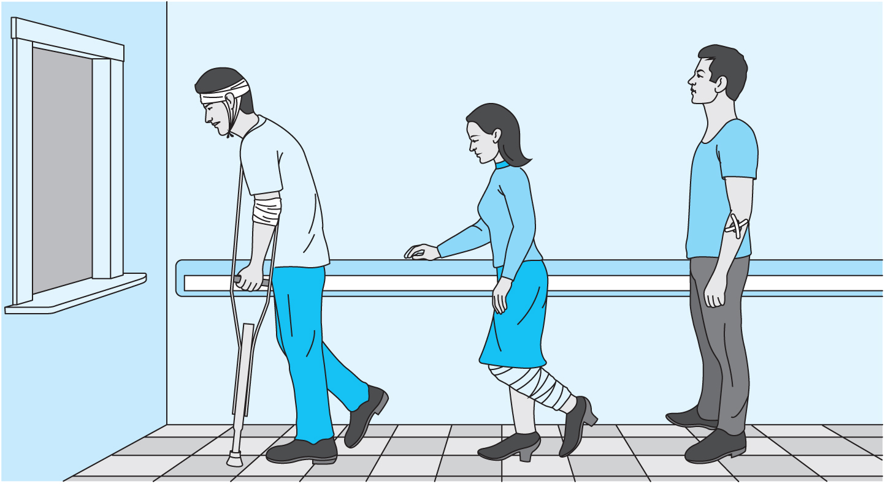
ADT Priority Queue
Priority Queue: An ADT in which only the highest priority element can be accessed
Figure 9.1 Real-life priority queue

Slide 3
Priority Queue: Logical Level
The operations on a priority queue are almost identical to those of a regular queue
Dequeue returns the highest-priority item instead of the oldest item
Transformers: Enqueue, Dequeue, MakeEmpty
Observers: IsFull, IsEmpty

Slide 4
Priority Queue: Application Level
Process scheduling in some OSes is ordered by the priority of the job
Emergency rooms triage patients so that the most urgent cases are handled first
Graduating seniors are given first choice when registering classes
Can also be used in sorting

Slide 5
Priority Queue: Implementation
Unsorted List: Dequeuing would required searching for the highest-priority item
Array-based Sorted List: Enqueuing would be
O(N) due to moving data
Linked Sorted List: Enqueuing is O(N) because finding the insertion point is a linear search
Binary Search Tree: O(logN) Enqueue and Dequeue – winner!

Slide 6
BST Drawbacks
BST efficiency is based on the tree’s height
The nature of Enqueue and Dequeue would lead to tall, “narrow,” and inefficient trees
Priority Queues only care about the highest-priority node; by relaxing the binary search property, we turn the tree into a heap that still provides O(logN) operations

Slide 7
Array-Based Binary Search Tree
BSTs can be stored in arrays; the relationships between nodes becomes an implicit property of the algorithms
The node at index X has its left child at X*2+1 and its right child at X*2+2
The parent of a node is at (X-1)/2

Slide 8
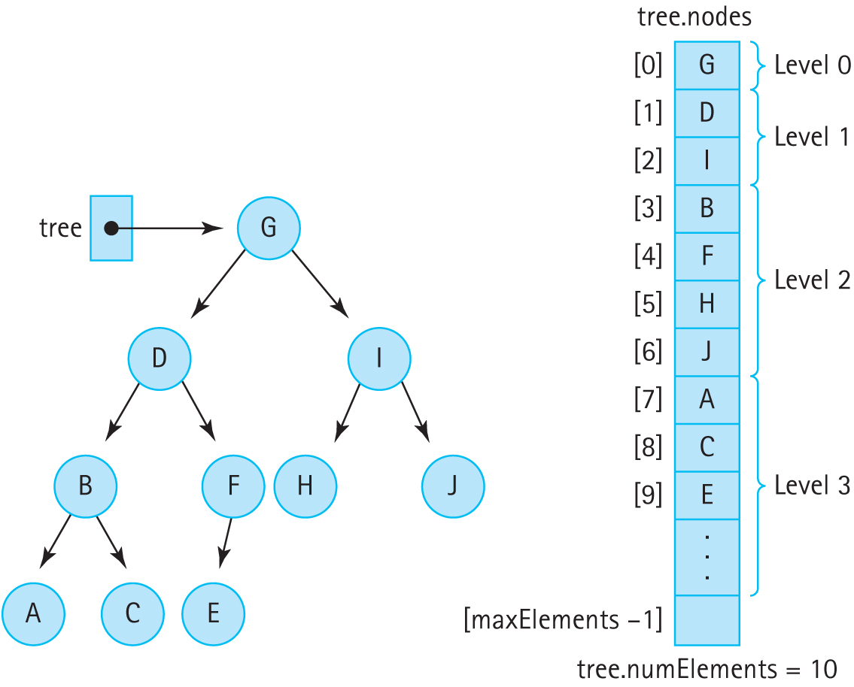
Array-Based BST
Figure 9.2 A binary tree and its array representation

Slide 9
Full and Complete Trees
Full Binary Tree: All leaves are located on the same level and all non-leaf nodes have two children
Complete Binary Tree: The tree is full, or full to the last level, with the leaves on the last level located as far left as possible
Array-based binary trees must be full or complete, or use dummy values

Slide 10
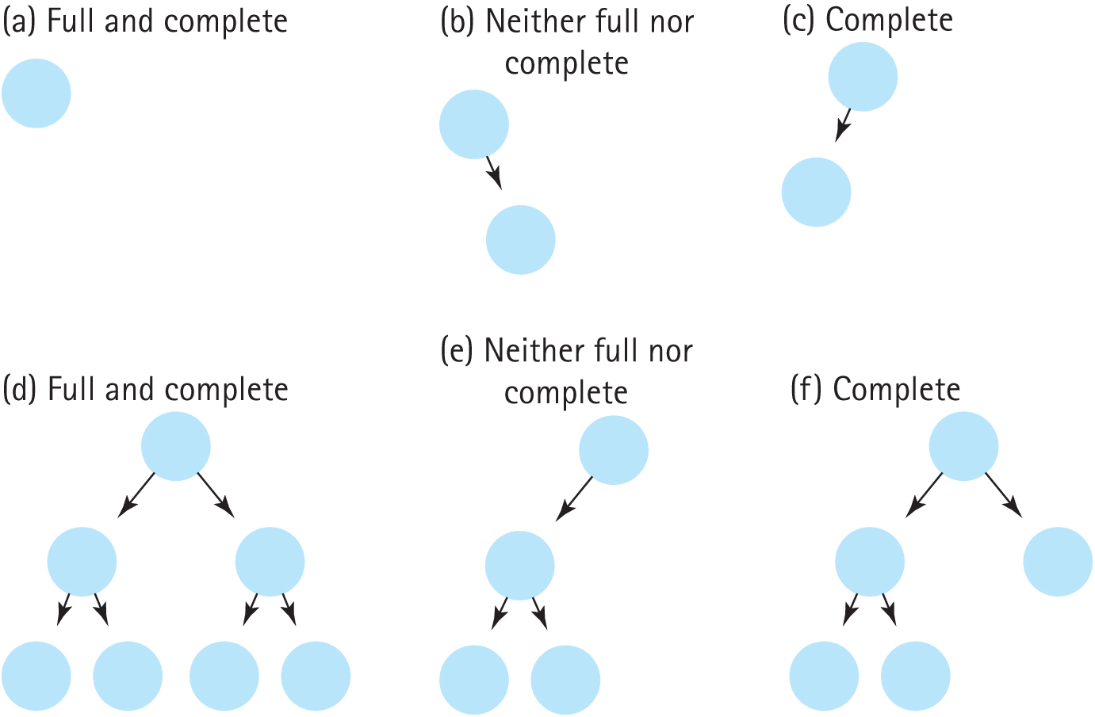
Full and Complete Trees (cont.)
Figure 9.3 Examples of binary trees (a) Full and complete (b) Neither full nor complete
(c) Complete (d) Full and complete (e) Neither full nor complete (f) Complete

Slide 11
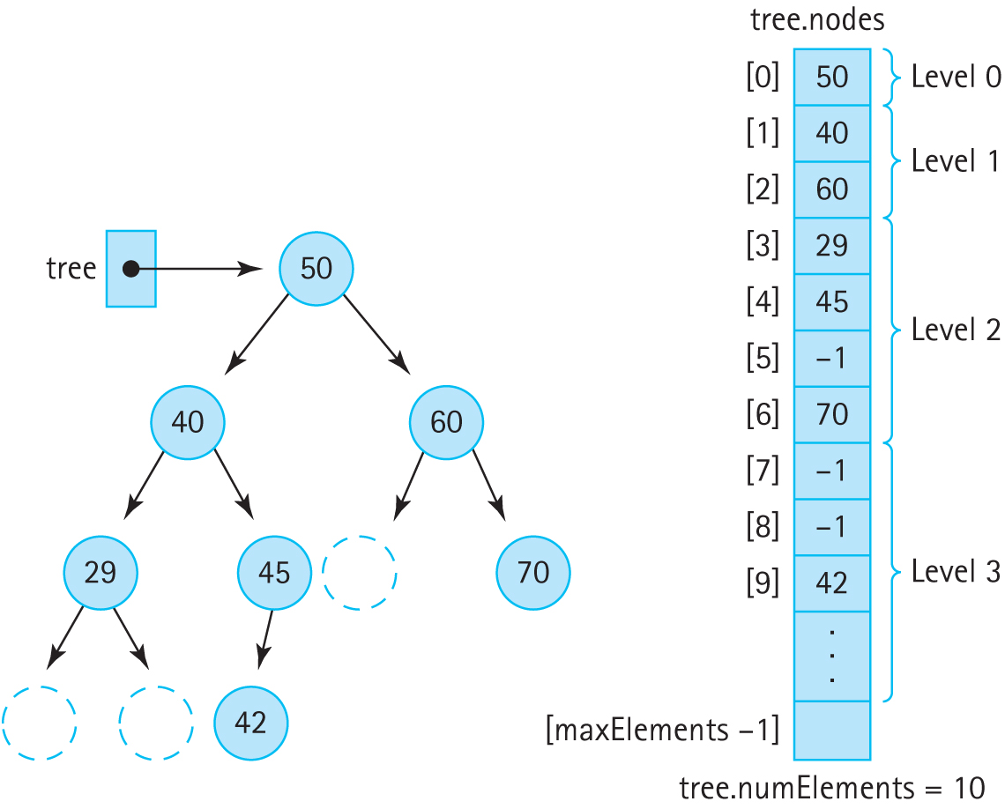
Using Dummy Values
Figure 9.4 A binary search tree stored in an array with dummy values

Slide 12
Heaps: Logical Level
Heap: A binary tree that fulfills two properties:
Shape Property: The heap is a complete tree
Order Property: The value of each node in the tree is greater than or equal to the values of its children
The root node has the highest value
Minimum heap: The parents’ values are less than their children’s values
Not to be confused with the memory heap

Slide 13
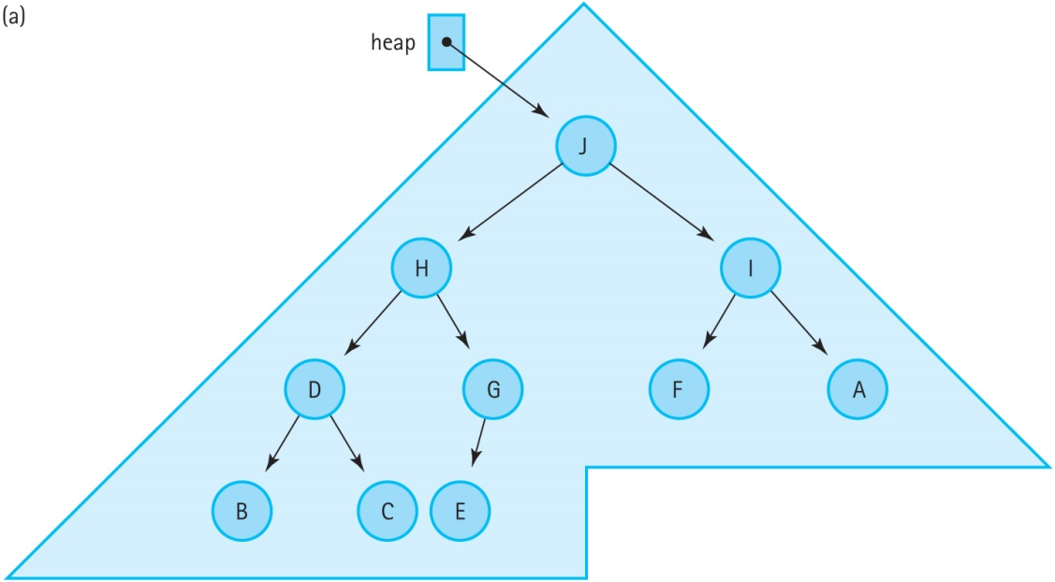

Heaps
Figure 9.5 Two heaps containing the letters “A” through “J”

Slide 14
Basic Heap Operations
ReheapDown: Given a heap that fulfills the order property except for the root, move the root node down until it is in a position that fulfills the order property
ReheapUp: Given a heap that fulfills the heap property except for the very last node, move the last node up the heap until the order property is restored

Slide 15
Heaps: Application Level
Heaps are primarily used to implement other structures and ADTs, such as priority queues

Slide 16
Heaps: Implementation Level
Because heaps are always complete, an array-based implementation is used
Heaps are rarely used alone; it makes sense to write the HeapType as a struct so that all members are public

Slide 17
HeapType
template<class ItemType>
// Assumes ItemType is either a built-in simple type
// or a class with overloaded relational operators.
struct HeapType
{
void ReheapDown(int root, int bottom);
void ReheapUp(int root, int bottom);
ItemType* elements;
int numElements;
};

Slide 18
Implementing ReheapDown
One of the root’s two children is the maximum value in the heap, due to the order property
By swapping the root and this child, the root is again the root of a heap that needs to be reshaped by ReheapDown
This continues recursively until the root is a leaf node or is in the proper place

Slide 19
ReheapDown Algorithm
If the root is a leaf node, do nothing
Find the maximum of the root’s children
If the root is less than the max child, swap the two nodes and recurse on the max child’s index, which now contains the root’s value

Slide 20
Determining Leaf Nodes
How do we check that a node is a leaf node?
Every non-leaf node must at least have a left child due to the shape property
The index of a node’s left child is index*2 + 1
If the index of a node’s left child is greater than the index of the last node in the tree, the node is a leaf

Slide 21
Implementing ReheapUp
If the node is the root of the heap, do nothing
If the node is greater than its parent, swap the node and its parent
Repeat the previous step recursively until the node is the root of the heap or it is less than or equal to its parent
Index of parent = (index of node - 1) / 2

Slide 22
Heaps and Priority Queues
Dequeue returns the highest priority item, which is the root of the heap
This leaves a hole at the top of the heap; like with UnsortedType, this hole can be filled with the bottom element of the heap
But now the order property may be violated by the root
Call ReheapDown to fix it

Slide 23
Heaps and Priority Queues (cont.)
Enqueue puts an element in the appropriate place in the queue by priority. How?
Start by putting it as the bottom element, thus preserving the shape property.
Now the bottom element of the heap may be violating the order property. Fix it using ReheapUp.

Slide 24
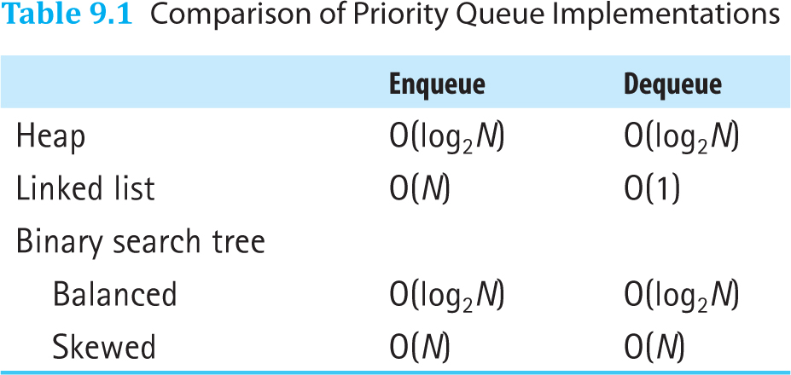
Heaps vs. Other Implementations
ReheapUp and ReheapDown are O(logN), so Enqeueu and Dequeue are O(logN)
Table 9.1 Comparison of Priority Queue Implementations

Slide 25
Heap Sort
A simple sort algorithm is to search for the highest value, insert it at the last position, repeat for the next highest value, and so on
Searching for the next highest value in the list makes this selection sort inefficient
By using a heap, there is no need to search for the next largest element
Remove the root, ReheapDown, repeat

Slide 26
Building a Heap
The unsorted list needs to be turned into a heap
It already satisfies the shape property: there are no holes in the array
ReheapUp and ReheapDown can reshape a heap, but only if their preconditions are met
Does the array meet the preconditions?

Slide 27
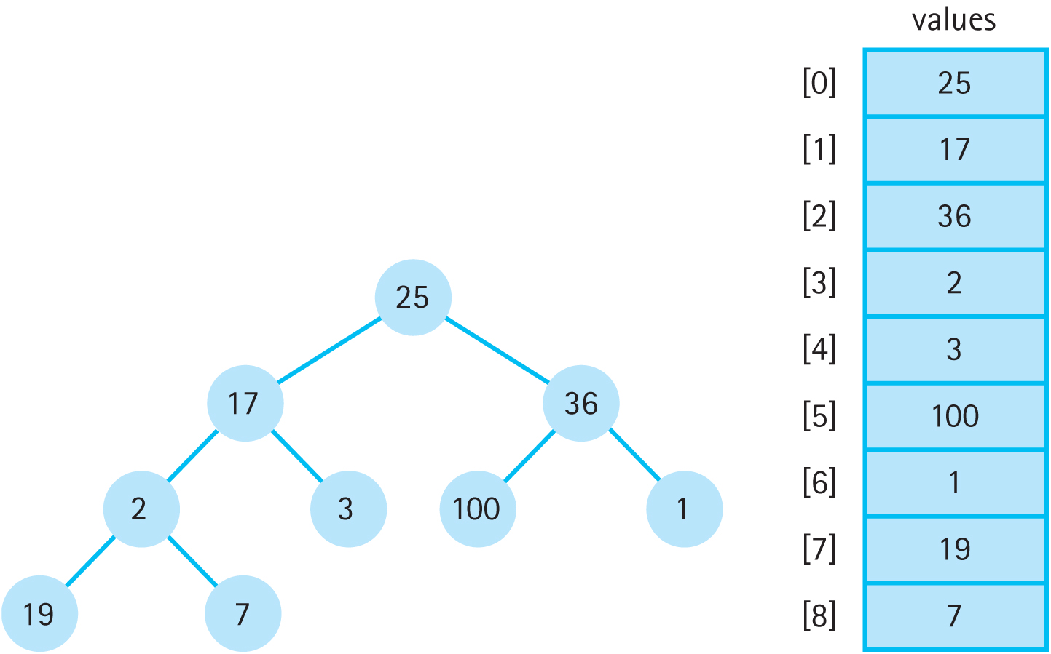
Example Array
Here’s an unsorted array and the tree it forms:
Figure 9.11 An unsorted array and its tree

Slide 28
Building a Heap
All the leaf nodes are heaps already
The heap rooted at 2 is almost a heap except for the root; this is perfect for ReheapDown
Calling ReheapDown on each non-leaf node from the bottom up turns the array into a heap
For convenience, ReheapDown is written as a global function that takes the heap as an additional parameter

Slide 29
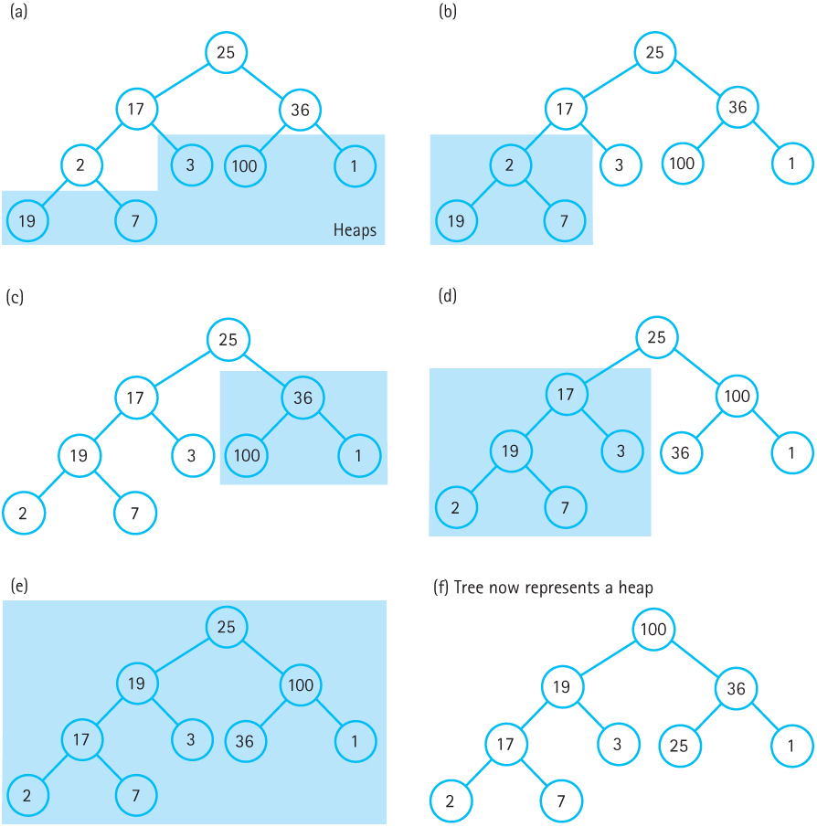
Building a Heap (cont.)
Figure 9.12 The heap-building process (f) Tree now represents a heap

Slide 30
Sorting with the Heap
Recall that Priority Queue’s Dequeue removes the root and replaces it with the bottom value, reducing the size of the heap by 1
Heap Sort swaps the root and the bottom value, then calls ReheapDown on the heap
The root, now at the end of the array, is in the correct position in the sorted list
The sorted list and the heap coexist in the array

Slide 31
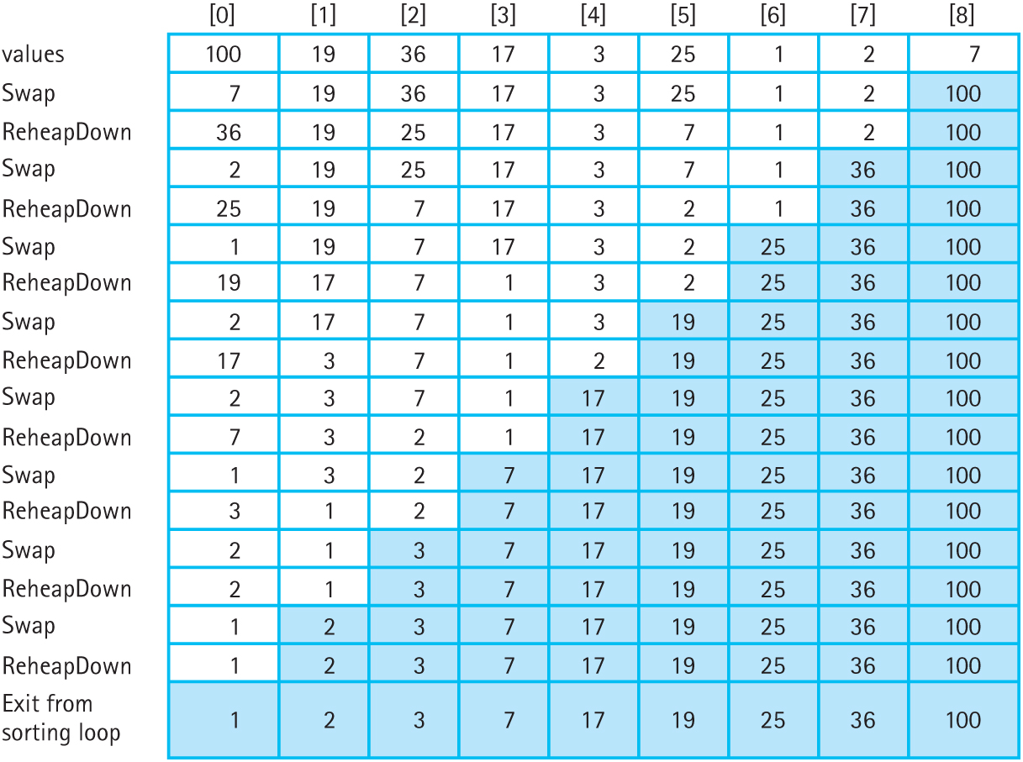
Sorting with the Heap (cont.)
Figure 9.14 Effect of HeapSort on the array

Slide 32
Heap Sort
The heap was only a temporary structure, used internally by the sorting algorithm
ReheapDown is O(log₂N) and was called each time an element was removed, so Heap Sort is an O(N log₂N) sort
Using an external heap would have cost twice as much memory

Slide 33
Heap Sort Code
template<class ItemType>
void HeapSort(ItemType values[], int numValues)
// Assumption: Function ReheapDown is available.
// Post: The elements in the array values are sorted by key.
{
int index;
// Convert the array of values into a heap.
for (index = numValues/2 - 1; index >= 0; index--)
ReheapDown(values, index, numValues-1);
// Sort the array.
for (index = numValues-1; index >= 1; index--)
{
Swap(values[0], values[index]);
ReheapDown(values, 0, index-1);
}
}

